Slide 1

Presented BY, Arjun.M DA & DS March Batch
GDP and Population Analysis

Slide 2
PROJECT OVERVIEW
Analyze global economic and demographic data (population, GDP, literacy, infant
mortality) from SQL and Excel sources using Power BI to uncover trends and
relationships.
Goals
Clean, merge, and prepare multi-source datasets.
Perform descriptive statistics and DAX calculations.
Build an interactive Power BI dashboard.
Highlight key global trends, rankings, and correlations.

Slide 3
Dataset Overview
Countries World (SQL) – Country details: population, GDP per capita, literacy, infant mortality, birth/death rates, economy sectors, etc.
PopulationPerCountry.xlsx – Annual population data (1960–2017) for each country.
Meta Data Country.xlsx – Region, income group, and special notes for each country.

Slide 4
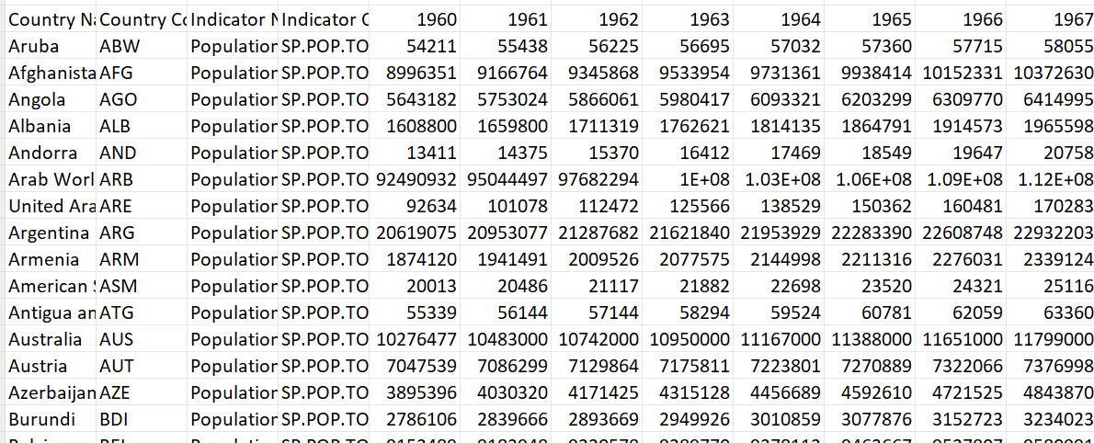
Data Cleaning
Removed duplicates & irrelevant records
Handled missing values
Converted data types for consistency.
Merged datasets using Country Code & Country Name.
Created DAX measures for GDP/Population growth & per capita values.

Slide 5
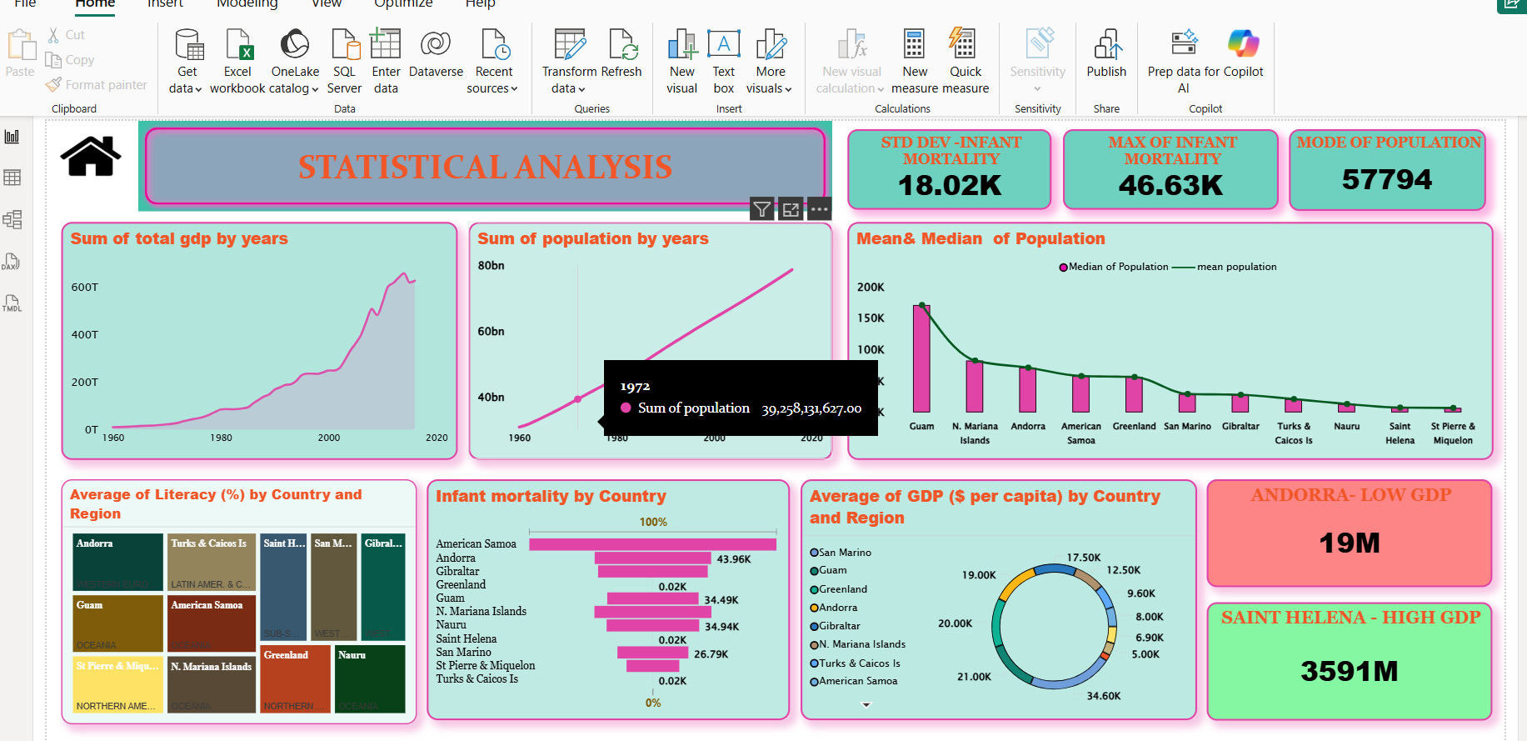
Statistical Analysis
Basic stats for population, GDP, literacy, infant mortality.
Highest & lowest GDP per capital.
Regional averages & distributions.
Growth trends (1960–2017).

Slide 6
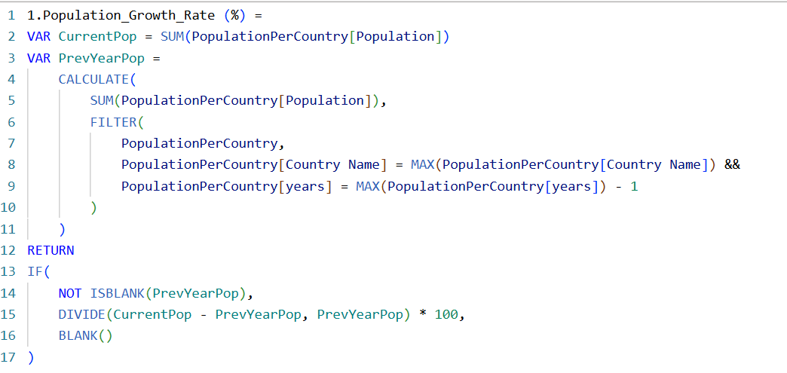
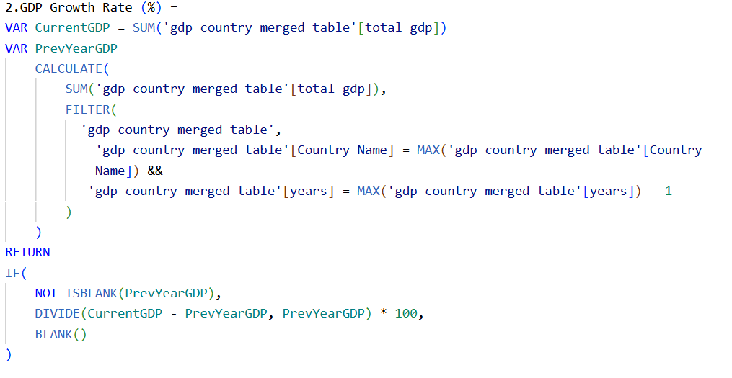
DAX Functions
Population Growth Rate = % change over years.
GDP Growth Rate = % change over years.
GDP per Capita = GDP ÷ Population.
Regional GDP / Population = SUM by region.
GDP–Literacy Correlation .

Slide 7
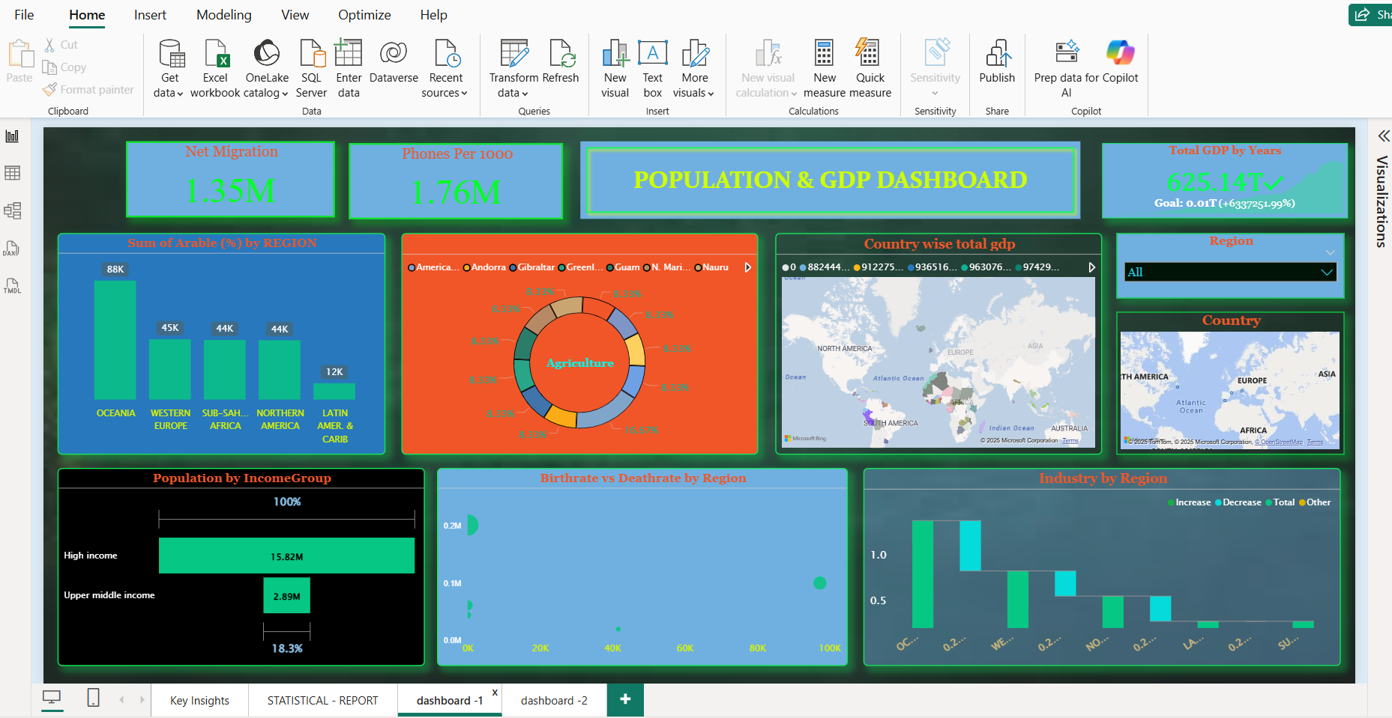

Slide 8
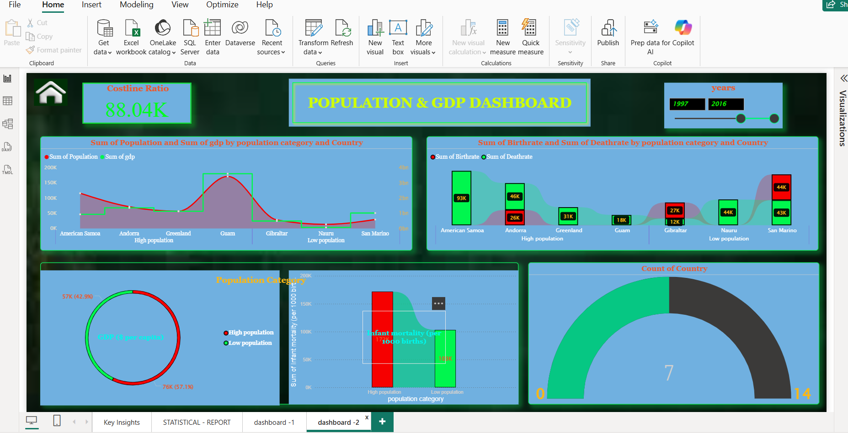

Slide 9
Key insights
Oceania has the highest population growth rate (382,352).
Andorra (19000) has the highest and Saint Helena (2500) the lowest GDP per capita.
Infant mortality is significantly lower in high-income regions.
Western Europe (3,989.70) has the highest and North America (0.00) the lowest population density.
GDP growth strongly correlates with literacy rates in most regions

Slide 10
Conclusion
High-income regions have higher GDP per capita and lower infant mortality.
Developing regions show rapid population growth but face economic and health challenges.
Literacy rates strongly correlate with GDP growth in most regions.
The interactive dashboard enables deeper exploration for data-driven decisions

Slide 11
THANK YOU

